Slide 1

McDOnald’s case Study
Ankit Gubiligari
Forough Mofidi
Danae Vassiliadis
David Zhu
Leadership and consulting | Fall 2023

Slide 2

Agenda
Problem Statement
Observations
Limitations
Next Steps
Questions

Slide 3

Problem Statement
Western Michigan Region of McDonalds franchise has been experiencing a loss of 5% customer traffic compounded over the last 3 years
Initiatives Attempted Thus far:
All-Day Breakfast Promotion Release
Increase in customer traffic
Decrease in operational efficiency
Concern for cannibalization
Determine alternate strategies to ensure higher profit margins/an increase in customer traffic
2013
5 %
2014
5%
2015
5%
Notes:
"McDonald's franchises in the Michigan region have been seeing a loss of 5% customer traffic compounded over the last 3 years. In efforts to divert the loss of customer traffic an All-day breakfast promotion was initiated. While evaluating the impact of the promotion, we saw an increase in customer traffic and diversity of clientele. However, our client saw a decrease in operational efficiency and is concerned about lower profit margins”
We have been tasked with assessing the causes of loss of customer traffic

Slide 4
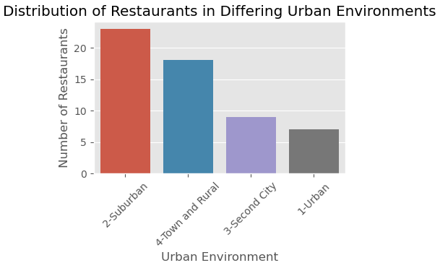
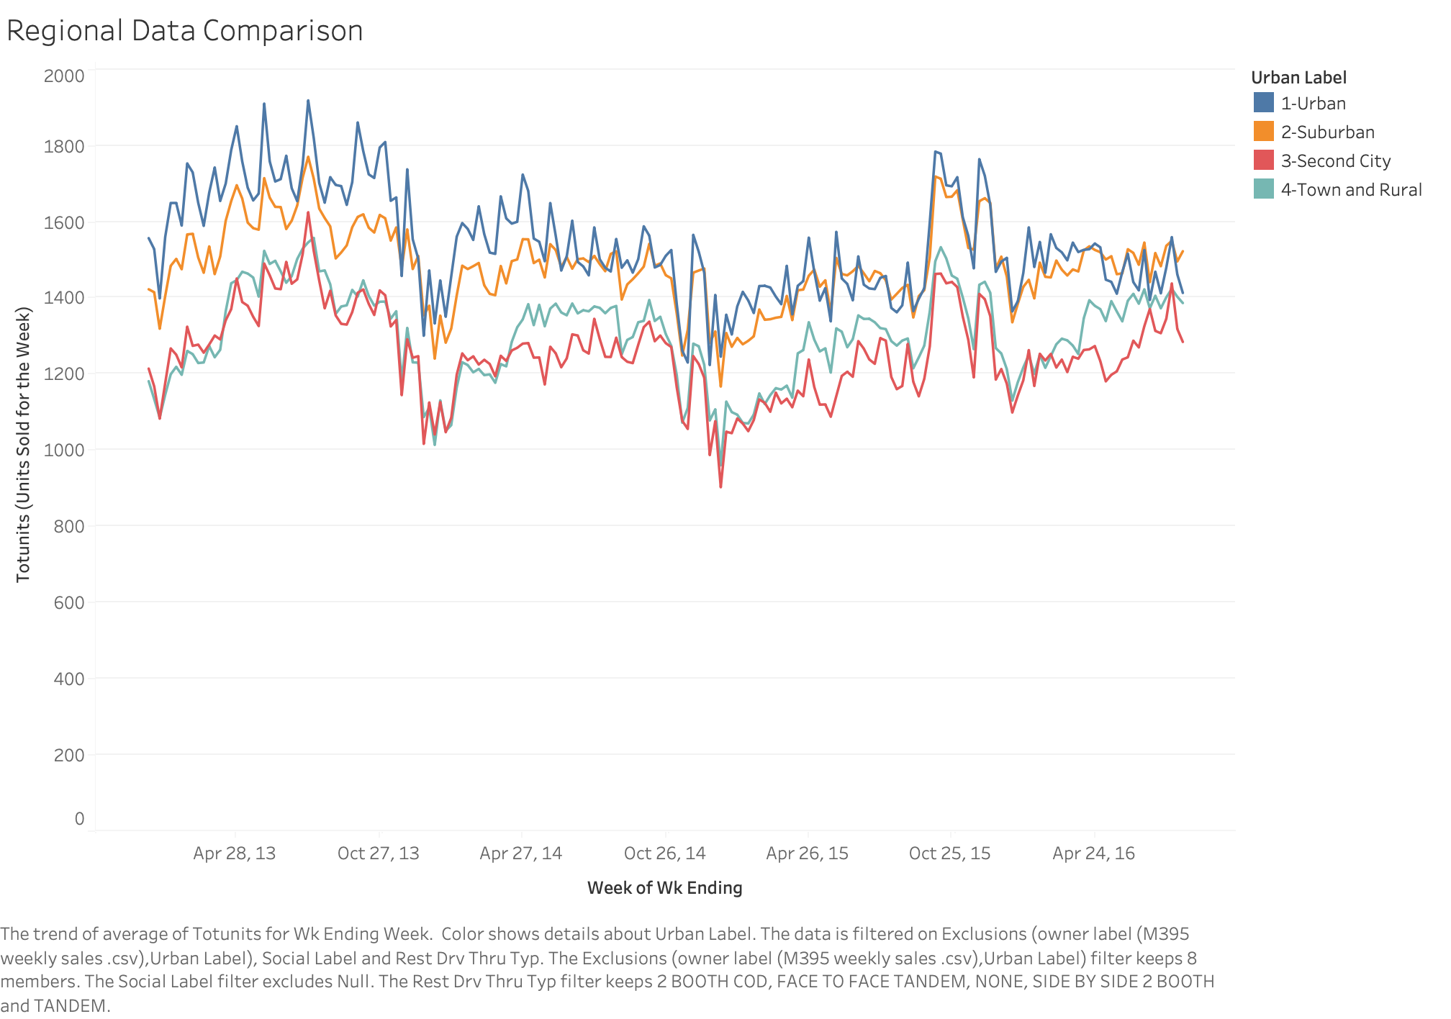
Urban vs Suburban
Observations
Urban vs Suburban
Restaurants have a greater distribution in suburban areas than urban, rural, or cities.
Urban restaurants are generating more revenue compared to suburban areas.
Notes:
Urban res. Are generating more revenue , western Michigan has more urban areas , further explore

Slide 5
Observations

Slide 6
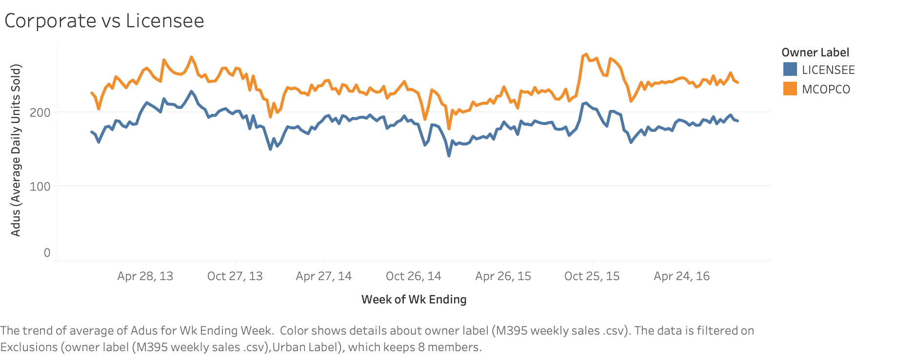
Licensee vs Corporate Ownership
Observations
More license owned stores compared to corporate owned stores (MCOPCO), however corporate owned stores seemingly bring in more revenue
What is the reason behind this difference? Are there any operational differences?
Notes:
Corporate owned : 19
Licensee : 45
What are factors are contributing to it?
Worth looking into the reason for this difference , and see whether there are any major operational or demographic differences.

Slide 7
All Day Breakfast Promotion
Observations
Spike in All Day Breakfast Items being purchased after promotion release
Slight dip in “Chicken Category” Sales after promotion release
Cannibalization may be present, however there is lack of proper insight into profit margin
Notes:
- cannibalization may be present but since we have no insight into profit margins we cannot say for sure

Slide 8
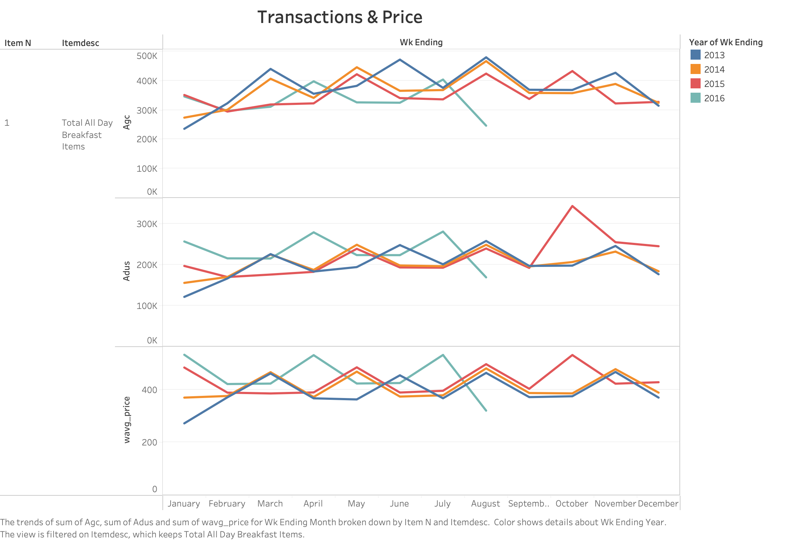
All Day Breakfast Promotion: Seasonality
Observations
Surveying trends of different sales metrics of the All-Day Breakfast Items over there seem to be consistent sales peaks in May, August, November
There is a notable change in seasonal behavior when the All-Day Breakfast promotion was released
The data for 2016 is incomplete, decreasing our visibility into post promotion release trends
Notes:
Use this insight to help us in running new promotions, determining when to release promotion
Leverage the peak in traffic time to Max profit

Slide 9
Limitations

Slide 10
Data Quality and Integrity
4 Years of Data
Detailing Sales Metrics & Restaurant Details
No cost of manufacturing data leads to a lack of insight into true profit margins of stores
This renders any current revenue/profit conclusions derived, irrelevant
Lack of order level details present in Sales Data disables the opportunity for proper clustering analysis
The demographic data present is not comprehensive; proper conclusions cannot be stated on income brackets etc.
1st Party Data
Internally Gathered
< 10% Nulls Present
Across both datasets making them negligible
Notes:
- We noticed a few constraints with the data you made available to us
-Firstly its important to note that we cannot properly calculate profit with no data on costs of manufacturing, operations etc.
- So while we can look at trends of revenue we cannot look at proper profit margins making it difficult to reach any hard conclusions such as whether the breakfast promotion is actually working
We also noticed the sales data is not order level which disabled any type of clustering analysis to be done (determinig what bundles of products maybe the best to promote)
- And lastly we found that the demographic data was limited and not accurately representative of the customer population

Slide 11
Next Steps

Slide 12
Next Steps
PHASE 1:
Additional Data Discovery- Clarification
Order Transaction Data, Profit Yielding Data
Third party data ; Census Data
Stakeholder interviews (Data/Operations team)
PHASE 2:
Site Visits
Capitalization of Urban Stores; site visits to understand the differences
Quality control for Licensee Stores to match the standards of corporate
PHASE 3:
Future Considerations
Confirm All-Day Breakfast Promotion effectiveness
New Promotion introduction
Promoting high yield items
Bundle promotion (beef/ chicken)
Notes:
Phase 1:
Order Transaction Data → Item- Item Clustering
Profit Yielding Data --> Understand Effectiveness of All Day Breakfast Promotion
Census Data → Demographic Targeting
Schule Site Visits to further investigate the operational differences and customer traffic of licensee vs coorporate and suburban vs urban stores
With the insights gathered concurrently in phase 1 and 2 we will likely be able to validate whether the all day breakfast promotion proves effective or suggest a better item bundeling for promotion and timings for promotion releases leveraging the peaks we see in seasonal customer traffic trends

Slide 13
Questions?

Slide 14
Action Items
Action | UC Owner | Client Stakeholder
Identify Data Sources | Danae Vassiliadis | ???
Schedule Interview | Ankit Gubiligari | ???
Schedule Site Visit | Forough Mofidi & David Zhu | ???
Notes:
we have some formal requests we need your input in we'd like to schedule some stakeholder interviews in order to identify additional potential data sources and schedule some site visits and wed like to know who would be the best person to touch base with in order to get working

